Slide 1
Module 2 Child Growth and Dev
Child Dev Class

Slide 2
Learning Target
The Student will recognize that development is a continuum with identifiable basic milestones.

Slide 3
Essential Question
What are the basic milestones in child development and growth?

Slide 4
Discussion Questions
What is a continuum?
What are milestones and why are they important?
What are red flags?

Slide 5
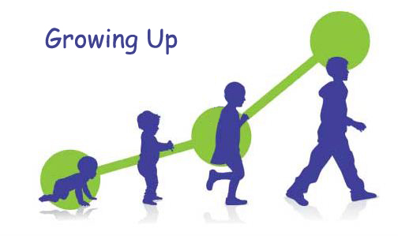
Development-
Refers to the gradual and predictable process of increasingly complex changes that occur over the course of a lifetime.

Slide 6
Growth-
Differs from development in that it usually means an increase in size or physical maturation--not an increase in the complexity of changes.

Slide 7
Child Development Stages are
Infants: 1 to 12 months
Toddlers: 1 to 2 ½ years
Ages 4 to 5 years
First grade--about age 6
Second grade--about age 7
Third grade --about age 8

Slide 8
Development is also separated into Domains
Emotional
Social
Intellectual
Physical and Health
These domains are simply a way to focus on different areas in which children are developing.

Slide 9
Child Development Continuum
A continuum is a continuous sequence or progression. A developmental continuum outlines the predictable order, or expected progression of skills.

Slide 10
Development
Moves from general to specific
from large to small
simple to complex
concrete to symbolic
For example, children’s first drawings of people are very simple-usually head with arms and/or legs. Over time they are more detailed.

Slide 11
Red Flags
Are warning signs that development may be delayed or atypical. These red flags are noticed when children don’t meet the milestones as expected.
Red flags are a cause for action but not alarm!

